Slide 1



Hospotality dashboard
View in Power BI
Last data refresh:
5/14/2024 6:38:08 PM UTC
Downloaded at:
5/14/2024 6:38:52 PM UTC

Slide 2
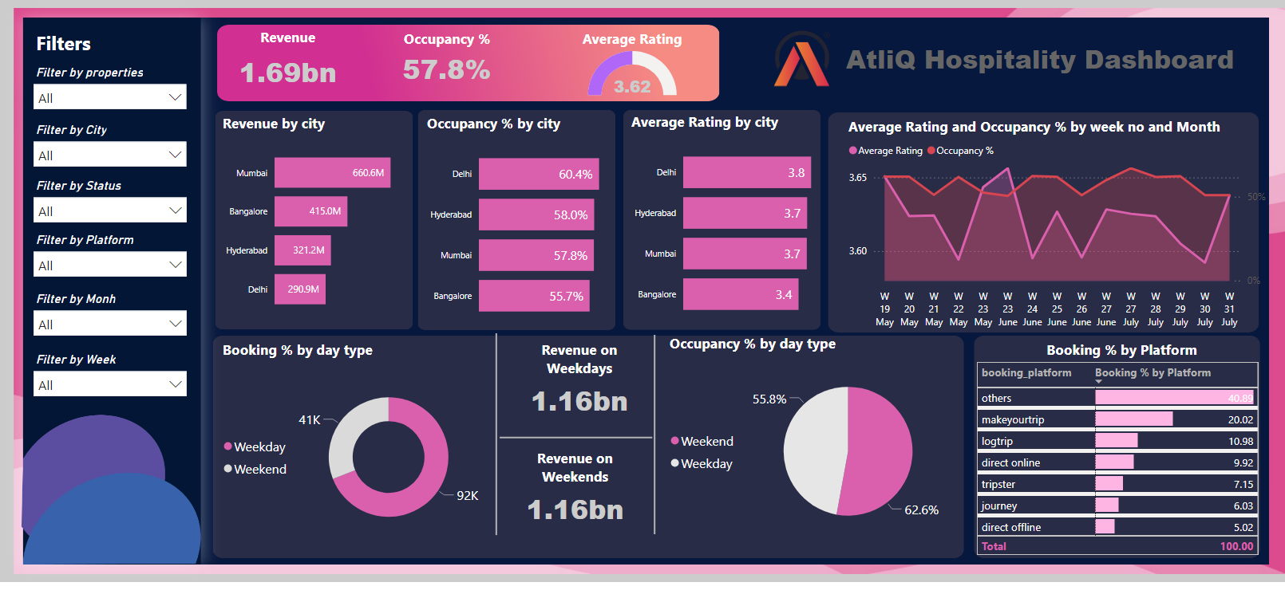
Page 1
Notes:
slicer
No alt text provided
slicer
No alt text provided
slicer
No alt text provided
slicer
No alt text provided
slicer
No alt text provided
slicer
No alt text provided
Revenue
No alt text provided
Occupancy %
No alt text provided
Average Rating
No alt text provided
textbox
No alt text provided
textbox
No alt text provided
Occupancy % by day type
No alt text provided
image
No alt text provided
clusteredBarChart
No alt text provided
clusteredBarChart
No alt text provided
Booking % by day type
No alt text provided
shape
No alt text provided
shape
No alt text provided
shape
No alt text provided
Revenue on Weekdays
No alt text provided
Revenue on Weekends
No alt text provided
areaChart
No alt text provided
Booking % by Platform
No alt text provided
clusteredBarChart
No alt text provided

Slide 3
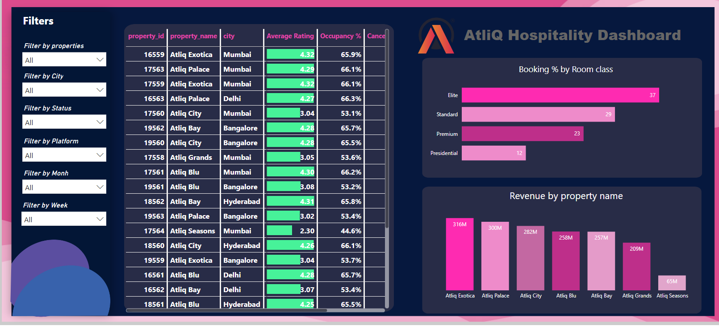
Page 2
Notes:
Property by Key Metrics
No alt text provided
slicer
No alt text provided
slicer
No alt text provided
slicer
No alt text provided
slicer
No alt text provided
slicer
No alt text provided
slicer
No alt text provided
textbox
No alt text provided
image
No alt text provided
textbox
No alt text provided
Booking % by Room class
No alt text provided
Revenue by property name
No alt text provided

Slide 4
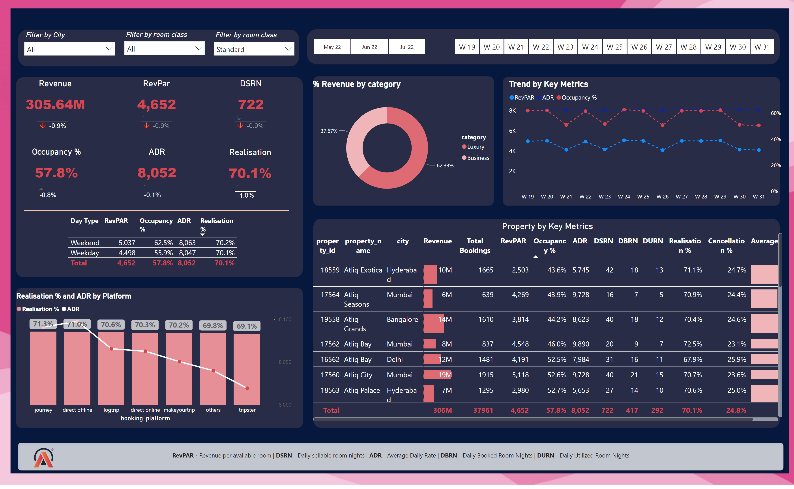
Home
Notes:
slicer
No alt text provided
slicer
No alt text provided
slicer
No alt text provided
Revenue
No alt text provided
RevPar
No alt text provided
DSRN
No alt text provided
Occupancy %
No alt text provided
ADR
No alt text provided
Realisation
No alt text provided
Property by Key Metrics
No alt text provided
Trend by Key Metrics
No alt text provided
tableEx
No alt text provided
Realisation % and ADR by Platform
No alt text provided
slicer
No alt text provided
shape
No alt text provided
image
No alt text provided
slicer
No alt text provided
tableEx
No alt text provided
textbox
No alt text provided
shape
No alt text provided
tableEx
No alt text provided
tableEx
No alt text provided
tableEx
No alt text provided
tableEx
No alt text provided
tableEx
No alt text provided
% Revenue by category
No alt text provided

